Slide 1
SMART AGRICULTURE USING IBM WATSON
DHARANI

Slide 2
Introduction
Plants are essential part of human life they maintain ecological balance as well as they provide various resources to human being
To maintain the issue related to plant conservation is major concern in one’s life
Using IBM Watson,node red ,open weather API , python we are creating a application to monitor temperature, humidity and moisture of the plants

Slide 3
Requirements
GitHub
Zoho writer
Slack
IBM academic account
IBM Watson cloud platform
Node red
Python IDE
Open weather API

Slide 4
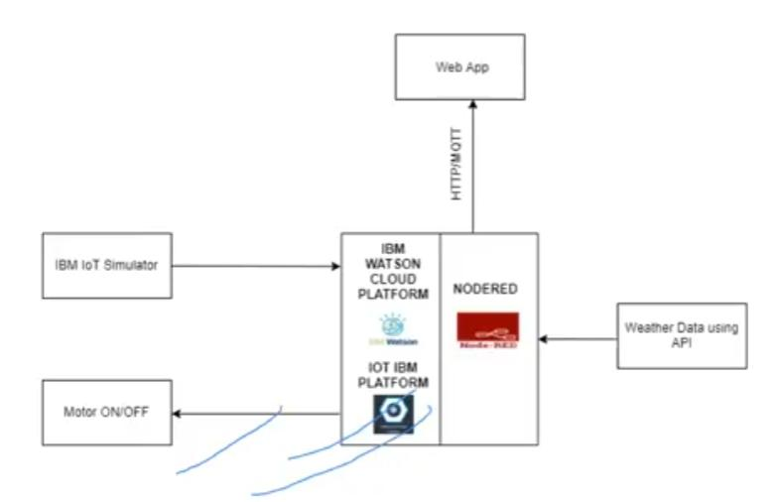
Block diagram

Slide 5
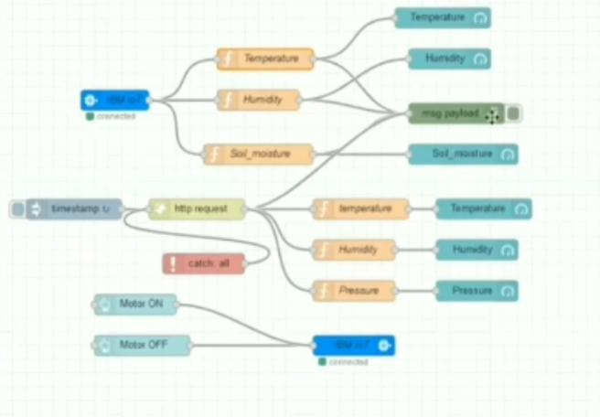
Node red flow

Slide 6
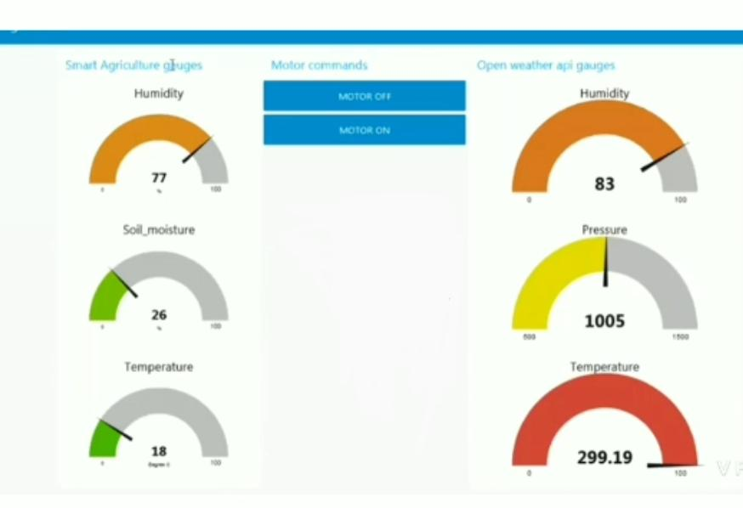
Application

